Slide 1

Week 5 Toolkit for Innovation & Entrepreneurship (Supply Side)
MM1031 Introduction to Innovation and Entrepreneurship
Dr. Edmond Yeung
Department of Management and Marketing

Slide 2
Agenda
Another handy tool for start-up business founders
Lean Canvas
How to prepare for a business solution (about your forum participation) like a design thinker

Slide 3
Video (5 mins)
What is Lean Canvas?
What is the different between Empathy Map and Lean Canvas?
How to use Lean Canvas to work out a solution for a Business / Social problem(s)?

Slide 4
How to prepare for your forum participation
Recall what you have learnt from the video and your own experience (1 min)
Use the Lean Canvas template and draft your own case (5 mins)
https://neoschronos.com/download/lean-canvas/docx/
Share your case with others
3-5 students in a group for 10 mins
Notes:
How the videos? Useful, Fun to watch

Slide 5
Empathy Map vs Lean Canvas
Empathy Map: Understand your customers: Experience, Painpoint, Expectations
Lean Canvas: Turn mkt demand into concreate solution; analyse the cost and revenue of the solution

Slide 6
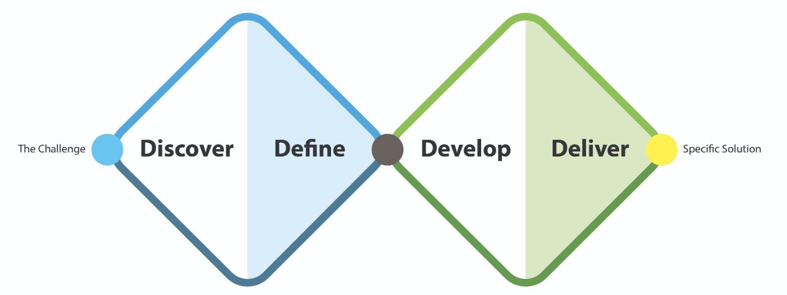
2. Double Diamond Model
Notes:
Framework: Double Diamond model
Diamonds:
1. Identifying and define the root course of the user's / business problems
2. Developing and deliver a human-centred / user friendly solutions for the problem / issues
Stages:
1. Discover: understand the problem, gather info
2. Define: Define the problem / find out the root cause
3. Develop: Brainstorm or Ideate the solutions (w/ different people)
4. Deliver: Testing out solutions at a small scale with users, select and improve the solution(s) that works
Notes: Non-liner process, focus on constant receiving feedback and continuous improvement (3 keywords for DT: Empathy, Co-creation and iterative)

Slide 7
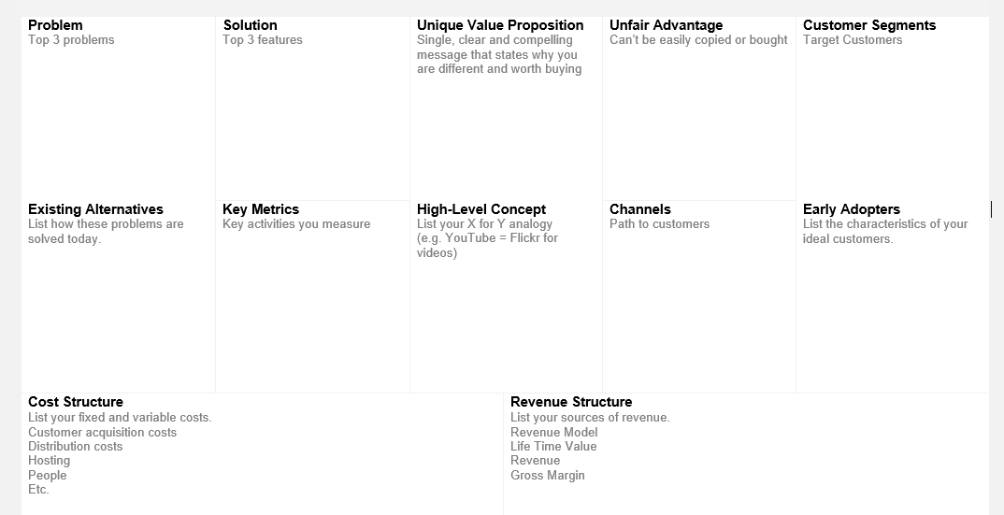
Prepare for your own Lean Canvas (5 mins)

Slide 8
Further resources in Design Thinking (In Week 5 Folder)
Stanford d.school's Design Thinking Process Guide
Harvard Business School 10 must-read articles
Design thinking in development engineering education

Slide 9
Seminar in Smart City and Ghost Net Hunter
Video recording is uploaded in Blackboard

Slide 10
Takeaway
Another handy tool for start-up business founders
Lean Canvas
Tasted the problem-solving process of what “Design Thinkers” do:
Learn, think, share and reflect

Slide 11
Announcement
Next Week: Reading Week (No Seminar)

Slide 12
Practices make perfect Have a nice day!

